Slide 1
BSE662A
End Semester Report
By Team Hoomans:
Aman Dixit
Kunal Singh
Pranjal Sharma
Raghavan Gopalan
Siddharth Gupta
Tanishq Gupta

Slide 2
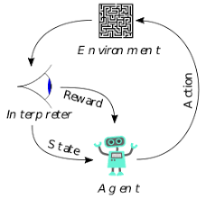

Need for Original Study
Standard models like Pearce-Hall account for only reward prediction errors
Emotions- nuisance variable/ internal proxy for value
Study needed to see effect of emotion prediction error on decision making

Slide 3
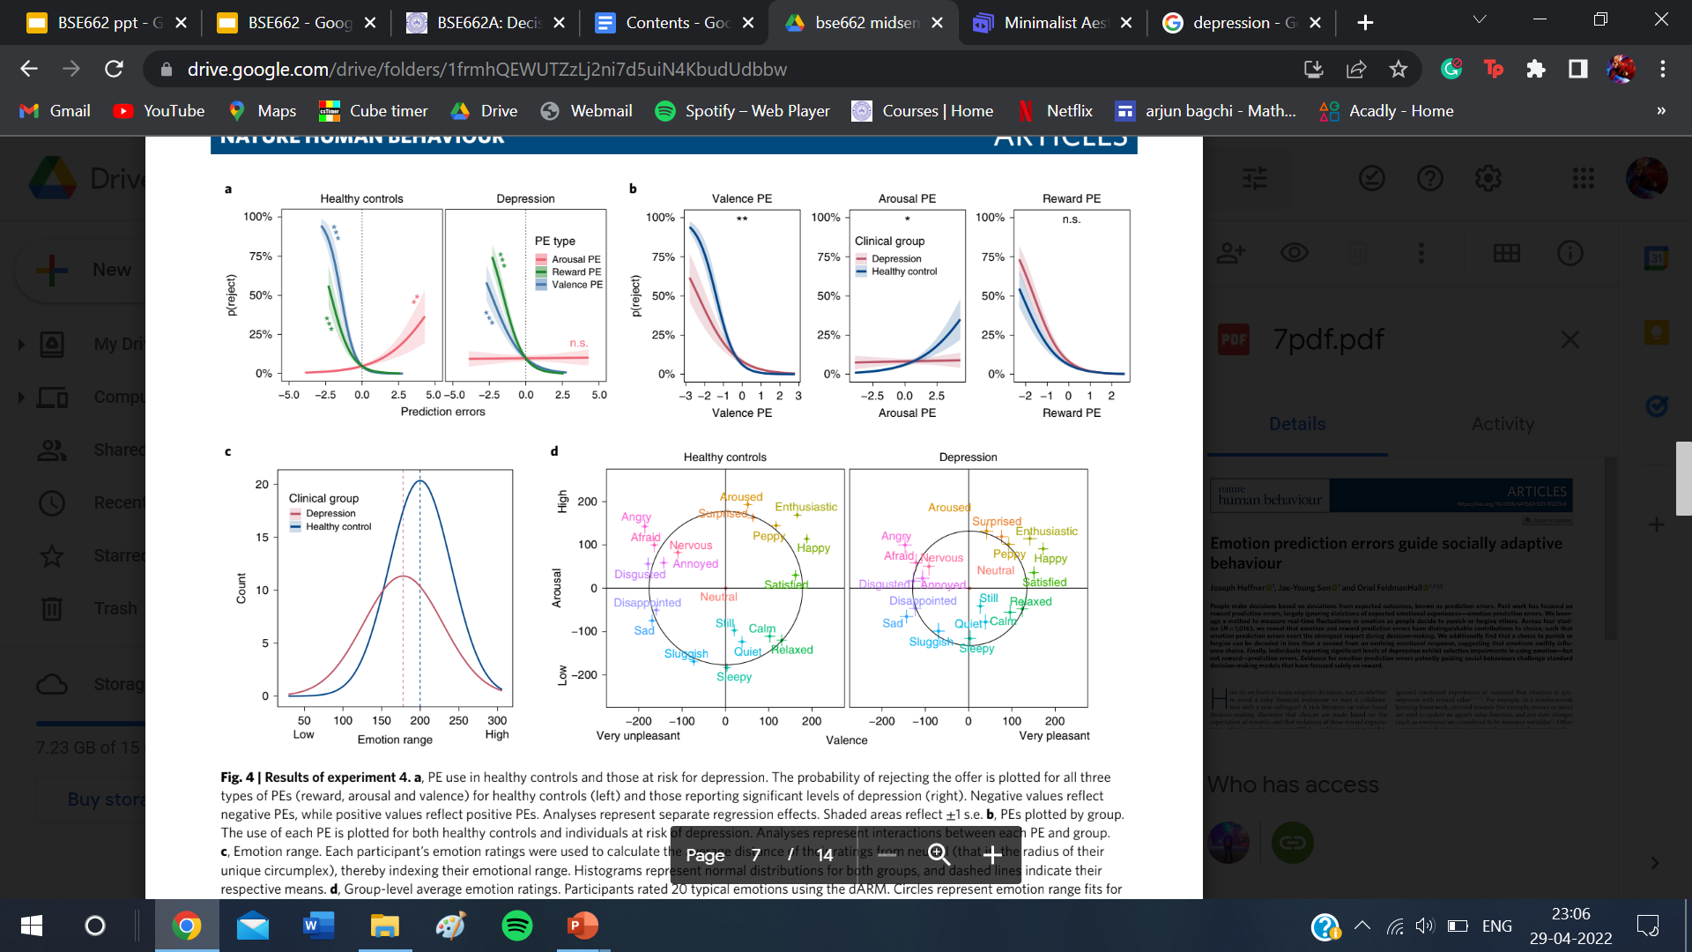

Dynamic evolution of emotion also explored
Emotional range and effect of emotion and reward PE in depression-risk individuals also seen

Slide 4
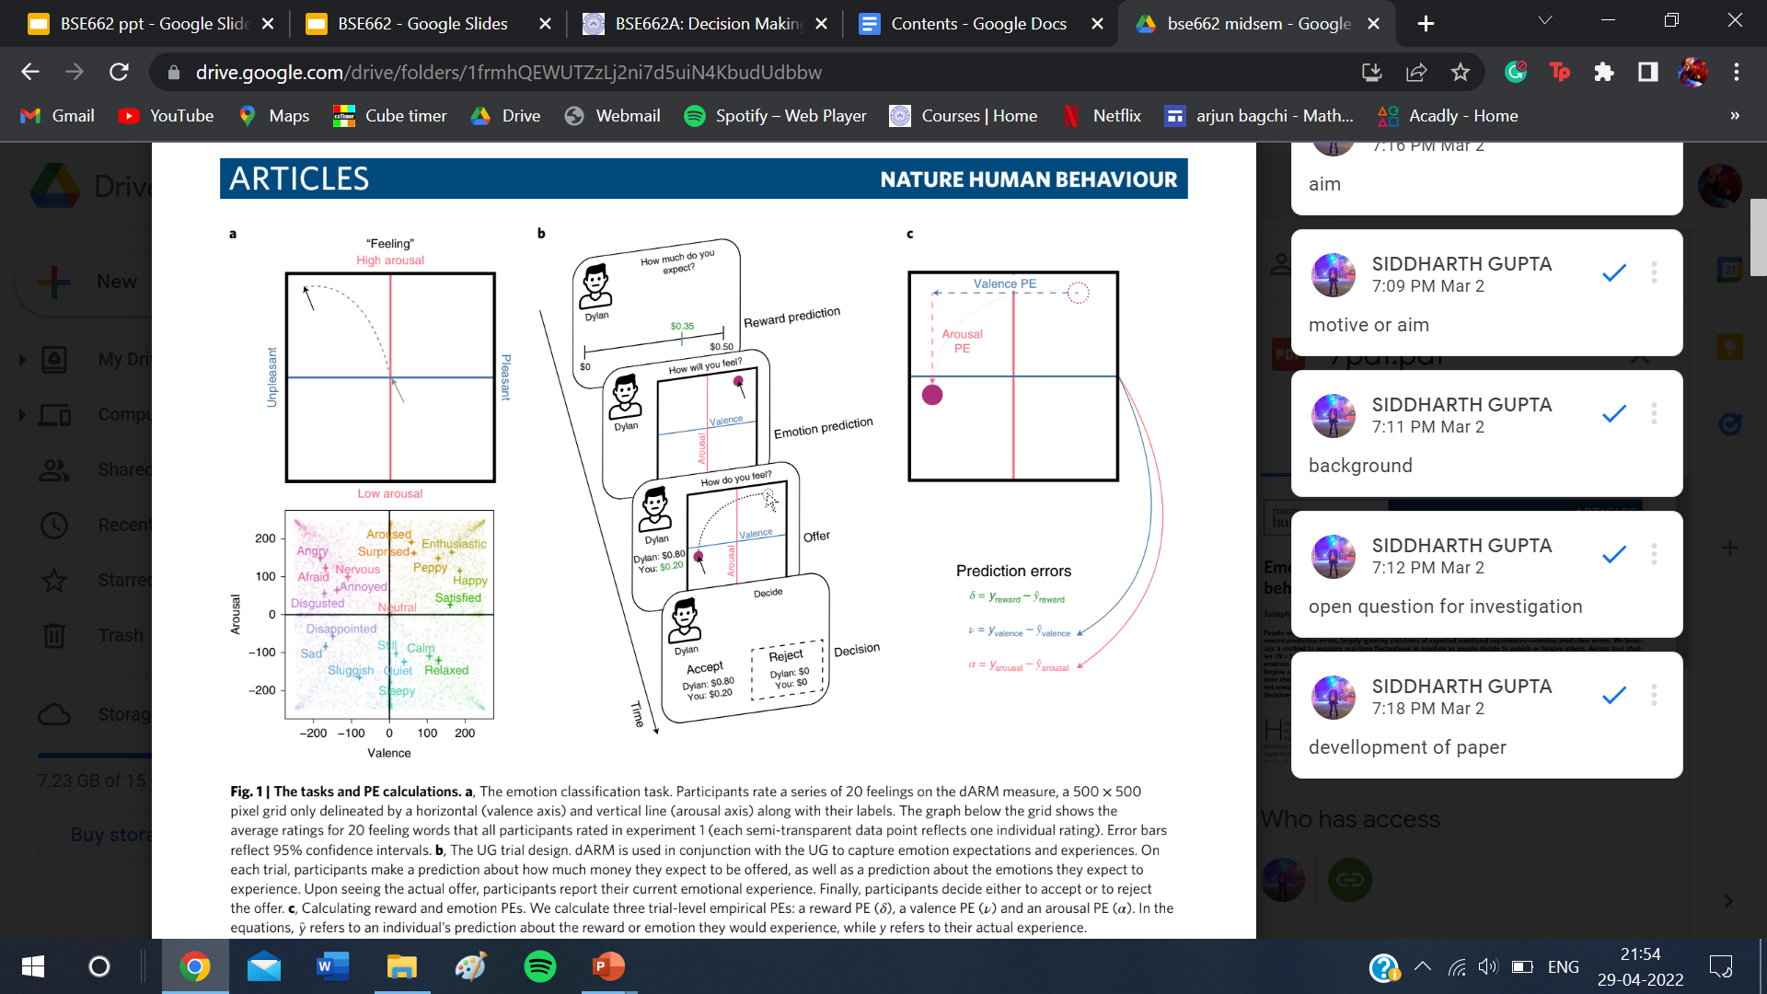
Limitations of Original Study
dARM formalism- not very accurate in determining PE
Proposer- anonymous, not always realistic in social scenario and may not produce same results as known proposer

Slide 5
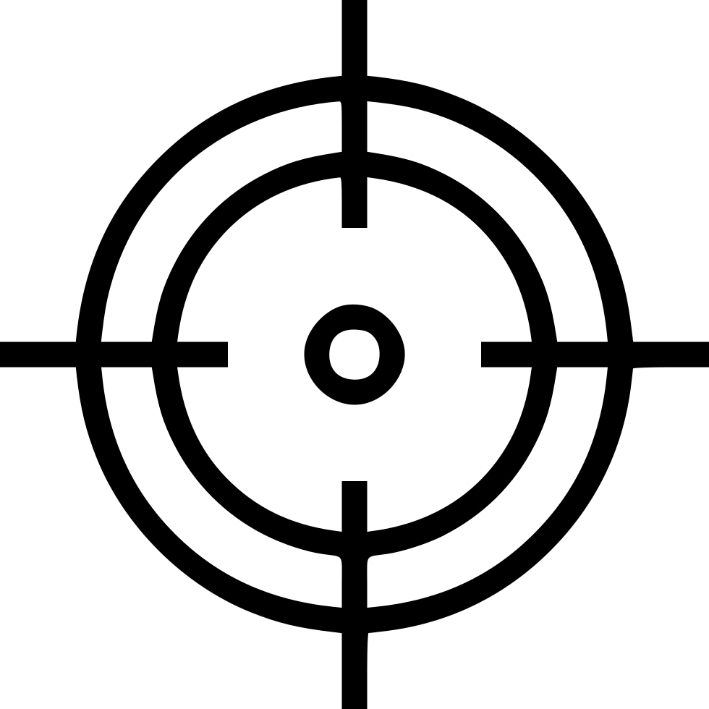
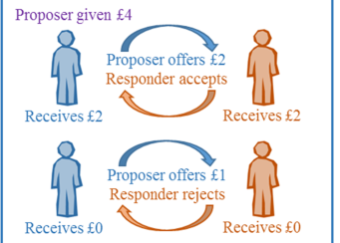
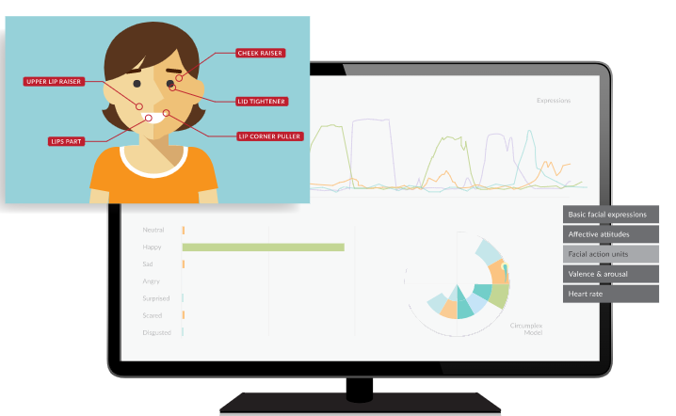
Aim of our Project
Replicate the original study- ultimatum game
Remove anonymity by having proposer familiar to participant
Emotion recognition software to test for emotionality, replacement for dARM

Slide 6
The Ultimatum Game

Slide 7
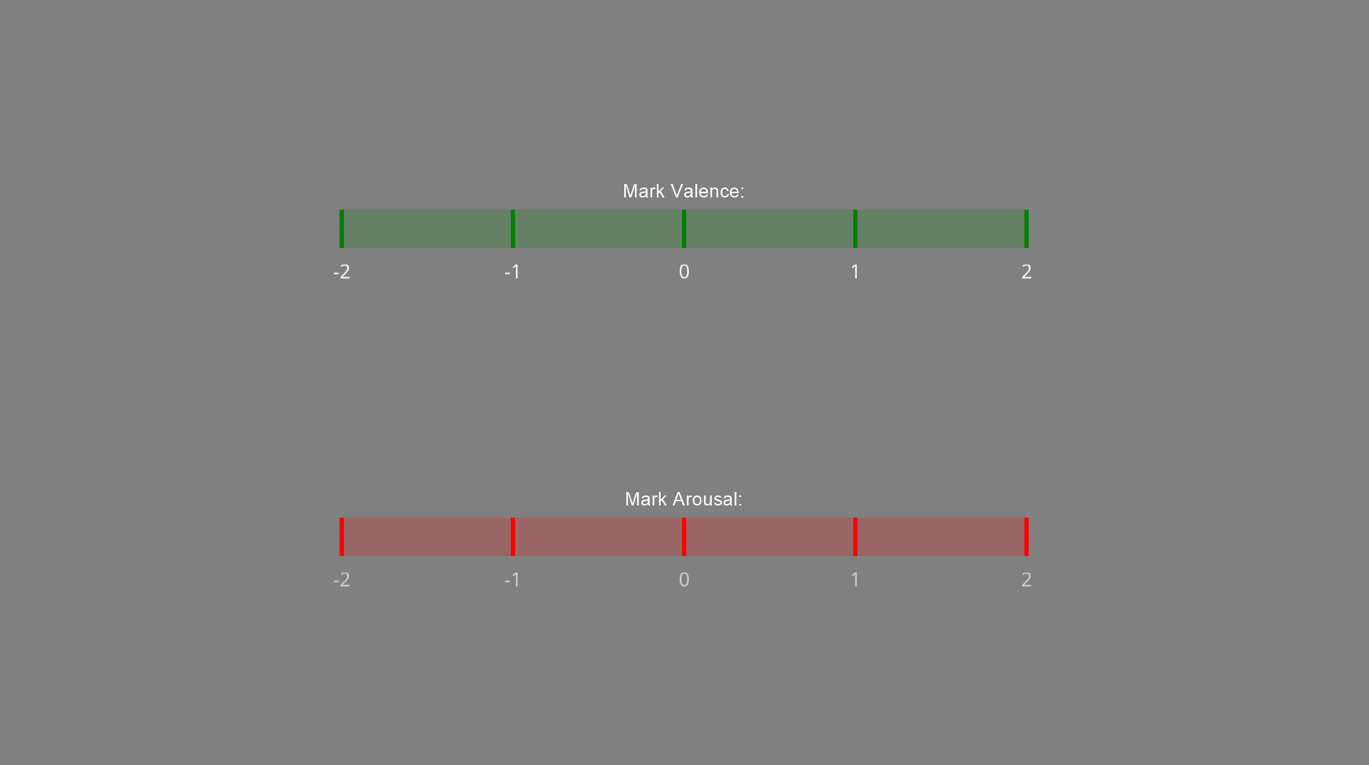
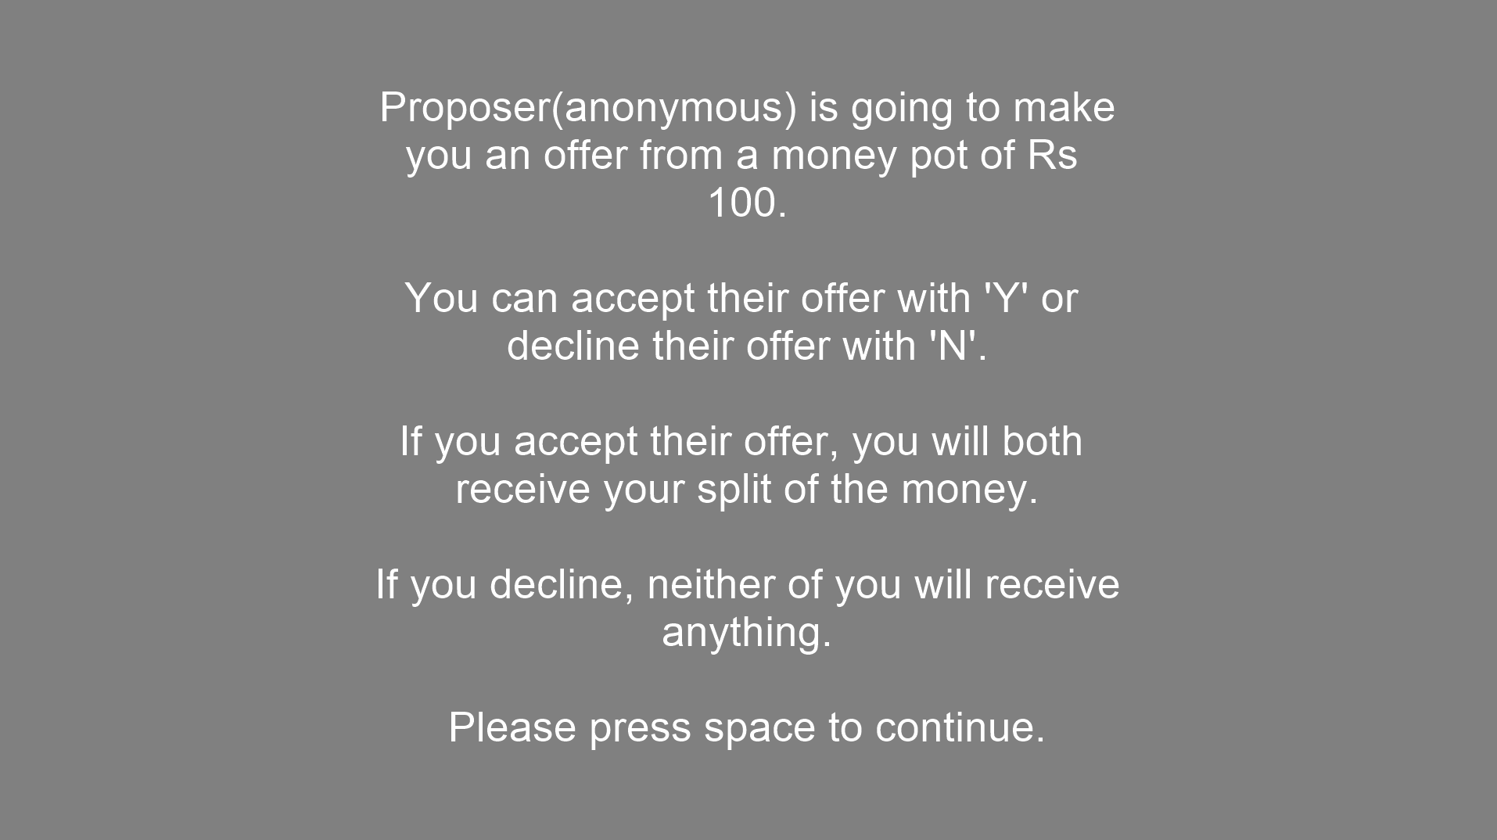
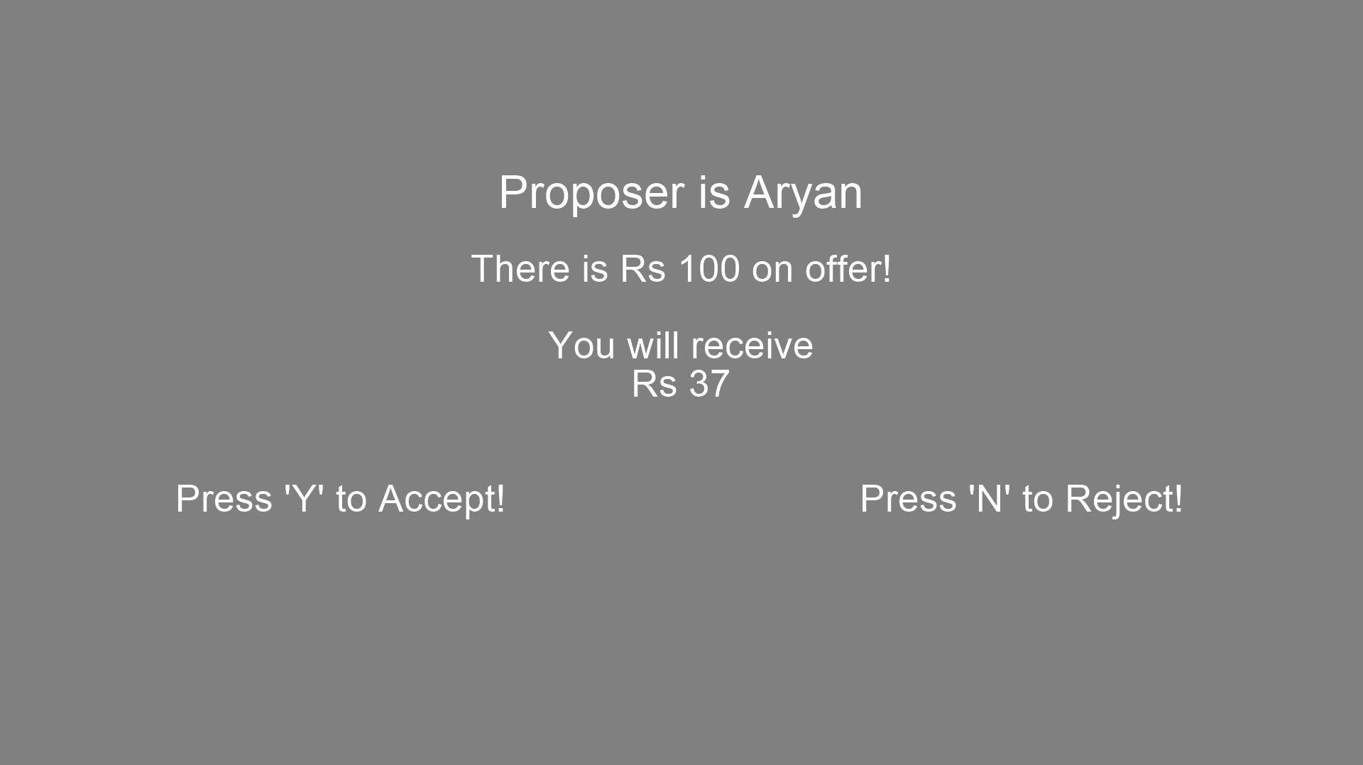
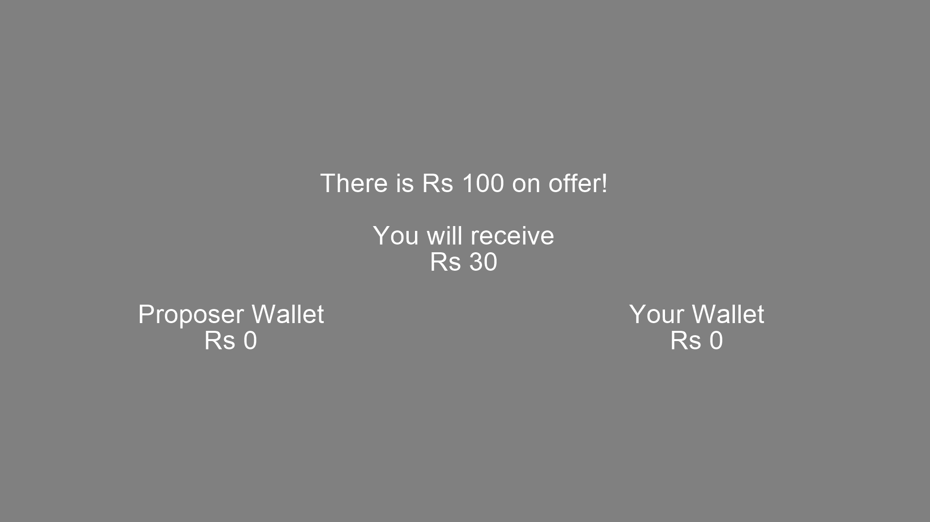

Slide 8
Experiment Setup
01
02
03
04
05
Pre-Processing
Participants
Trials
Winnings
Emotions
Taking offers for participants wing wise
30 Participants (3 wing, 10 participant per wing)
(5 anonymous trials + 5 non-anonymous trials) per person
Maximum Amount = Rs 35
Winnings = (Total Accepted Money / Total Offered Money) x 35 Rs
Emotions recorded using dARM as well as Emotion Recognition Software

Slide 9
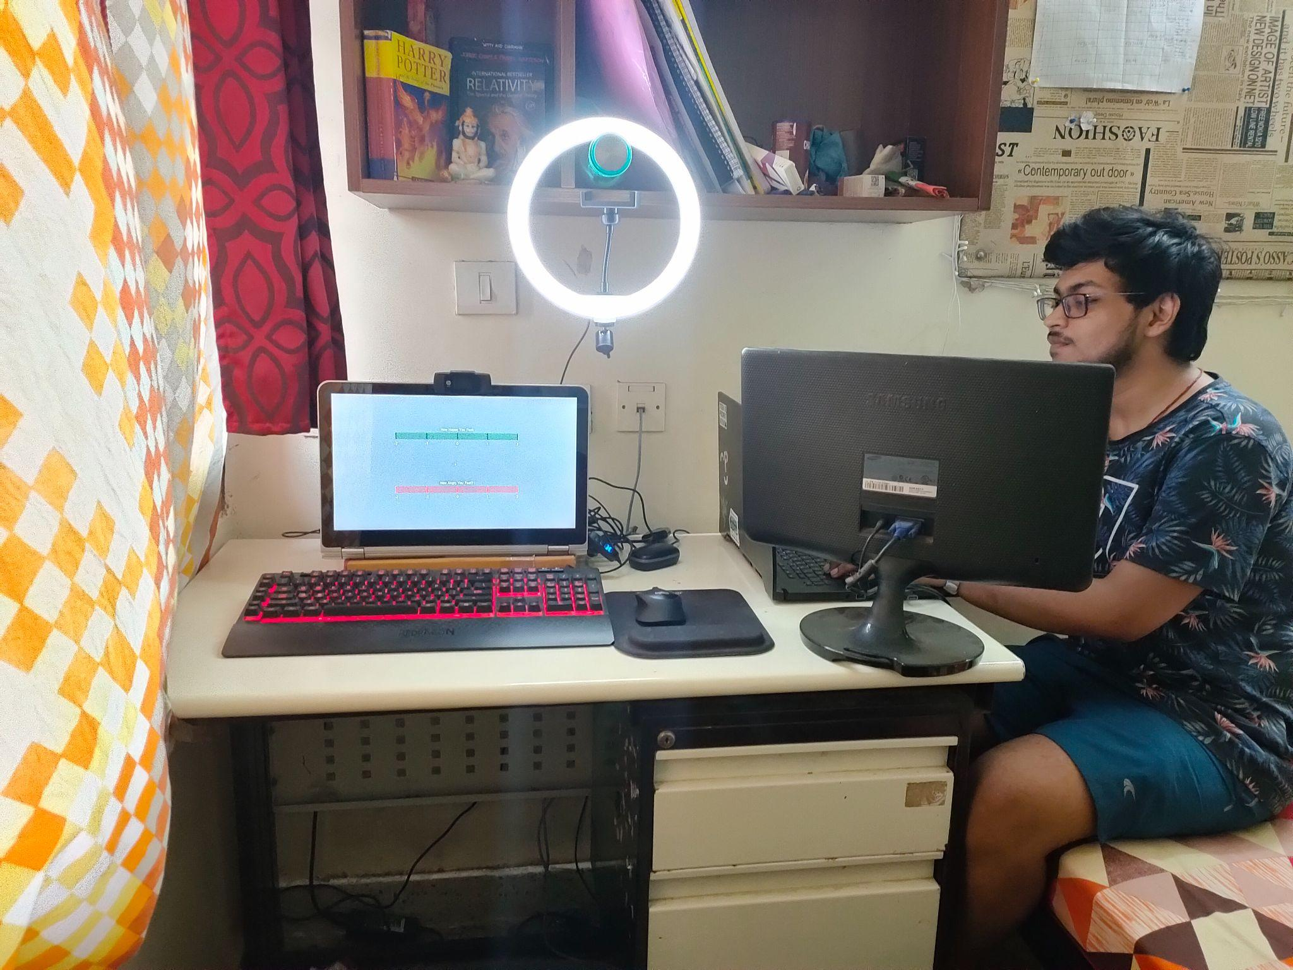
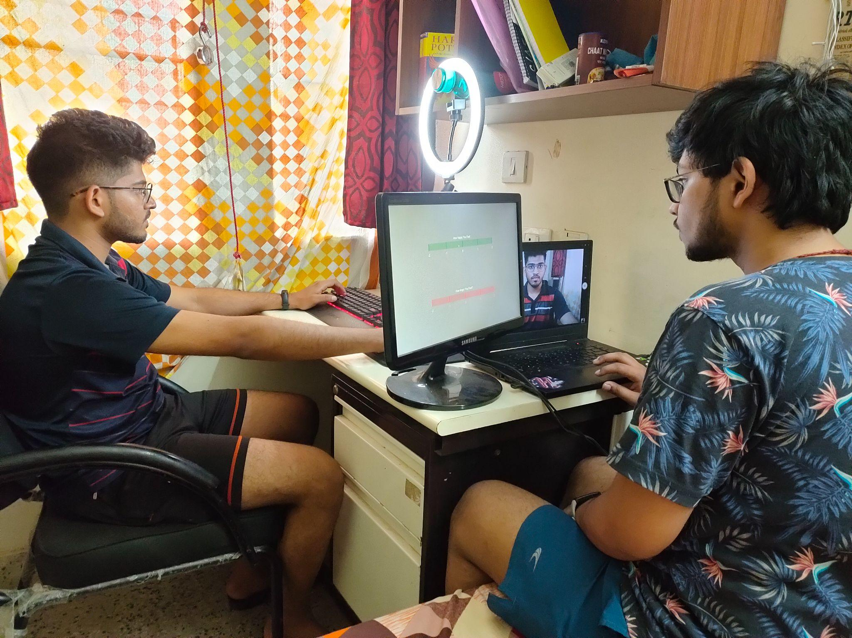
Our Setup for the conduction of the experiment

Slide 10
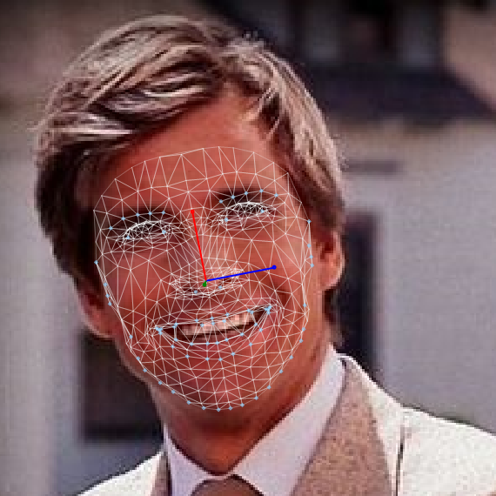
Emotion Recognition Software
Noldus FaceReader Software

Slide 11
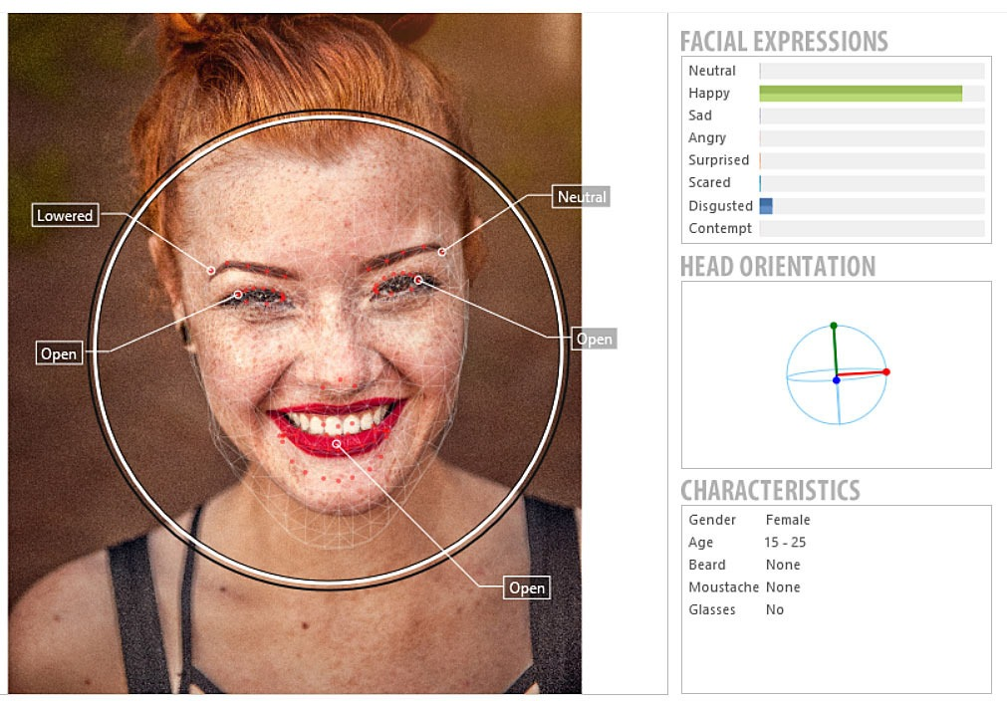
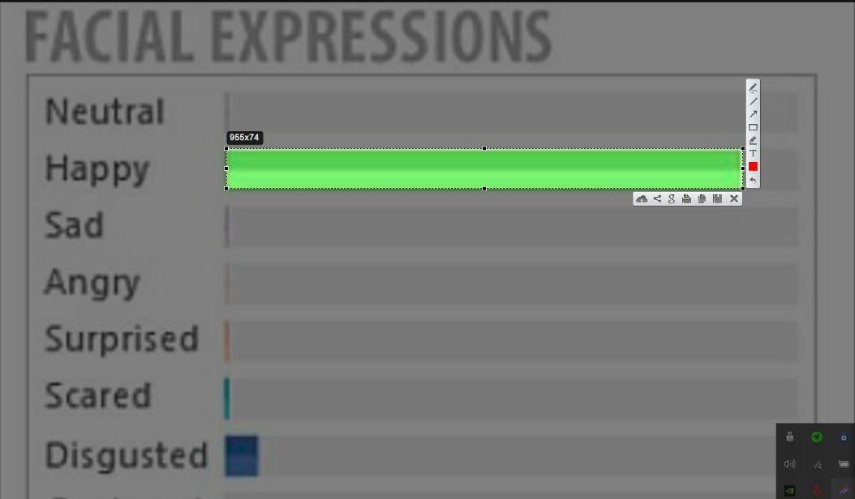
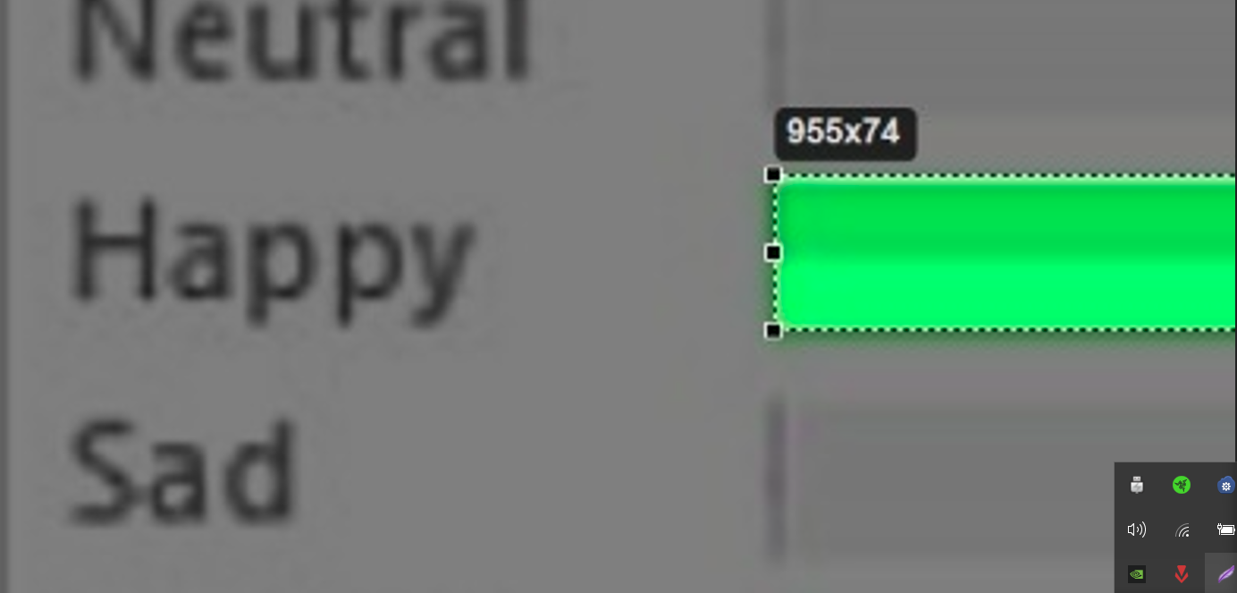
Noldus FaceReader Software and Its Analysis

Slide 12
Results

Slide 13
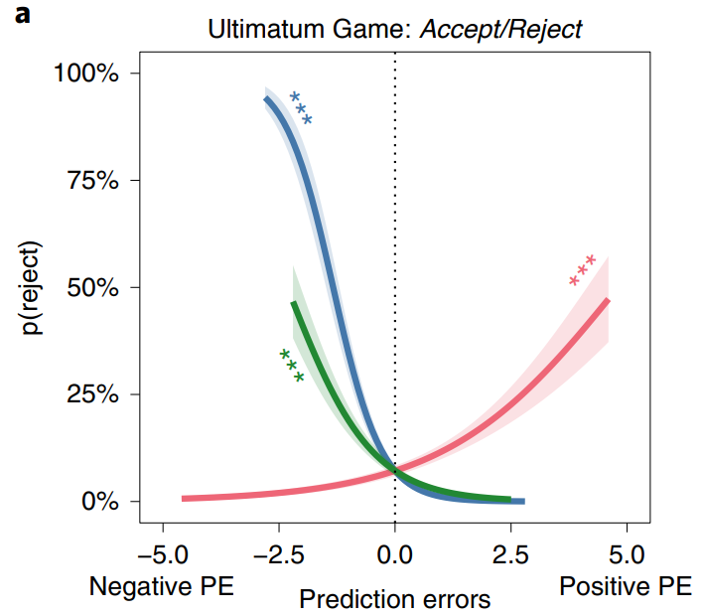
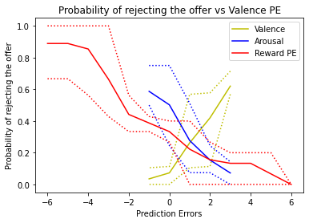
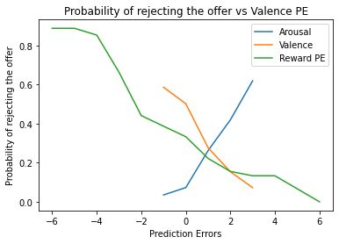
Results
Original Paper Result
Our Experiment Result
Anonymous Proposer

Slide 14
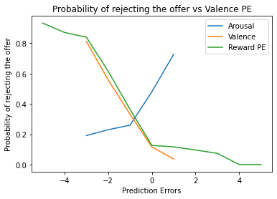
Results
Non-Anonymous Proposer

Slide 15
Results
Anonymous Proposer
Non-Anonymous Proposer

Slide 16
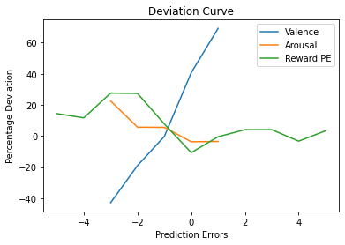
Results
Deviation between Anonymous and Non-Anonymous Graph

Slide 17
Significance of Non-Anonymous Result
Emotions take the front seat
Reward motivated decisions are reduced
Smaller Buffer Region for Rejection of Offer
Expectations Bar is Set Higher

Slide 18

Results for the Emotion prediction through facial expression
…..And
How it went ?
😱
Notes:
Boy ! it was unexpected

Slide 19

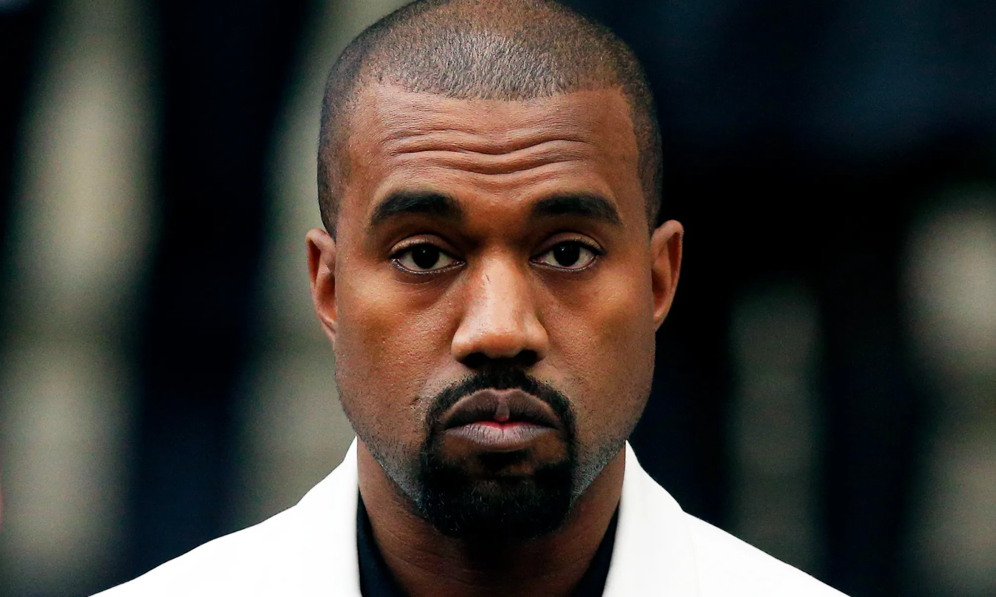
Why ?
Notes:
The core reason for that can be seen in our daily life, we be sending this emoji while making a face like this in reality. Yup, we all do that !!

Slide 20
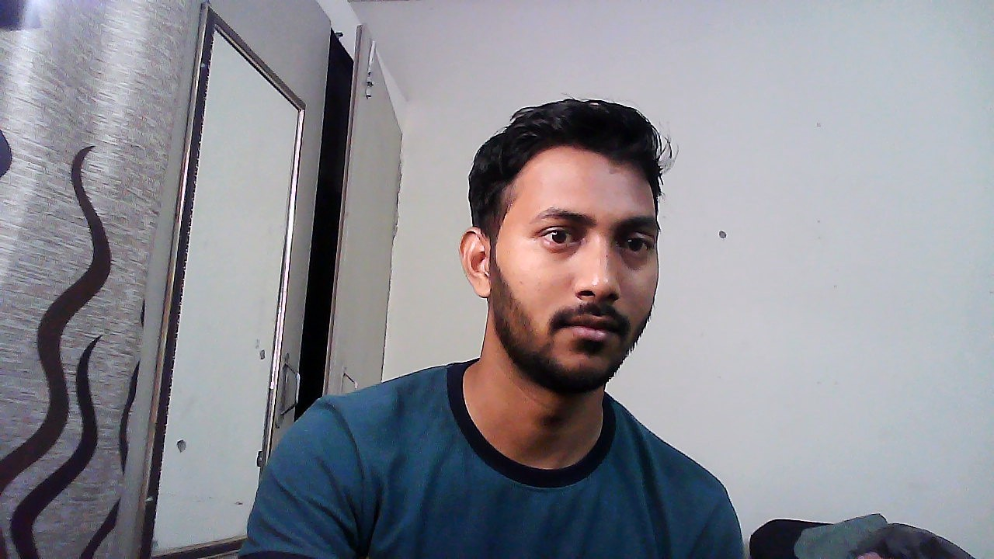
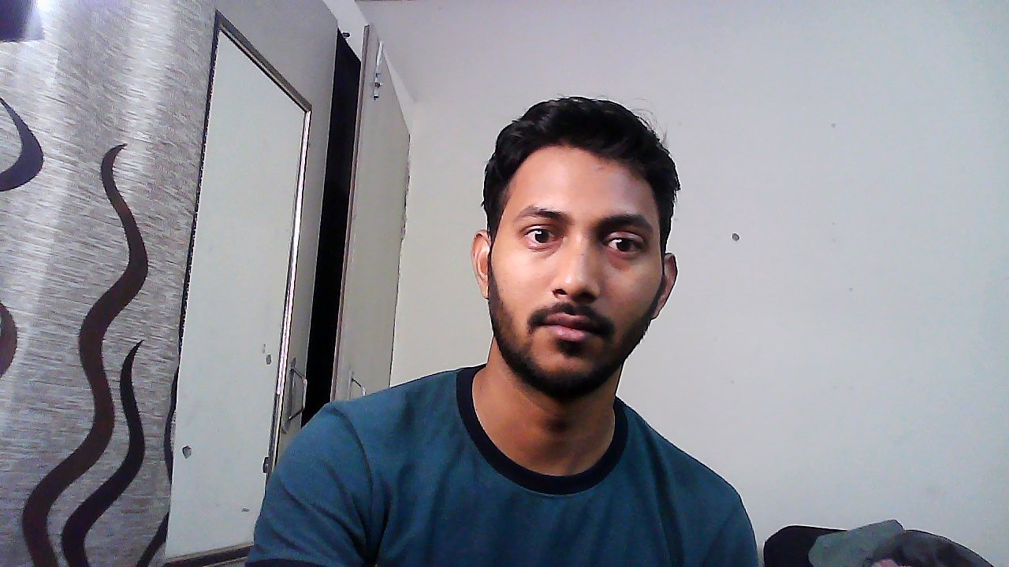
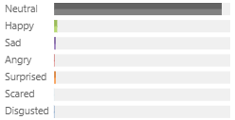
Look at these two images and their results :(
Notes:
Just look at these two images, no difference of emotions. Difference maybe so subtle that our software and eyes cant differentiate.

Slide 21
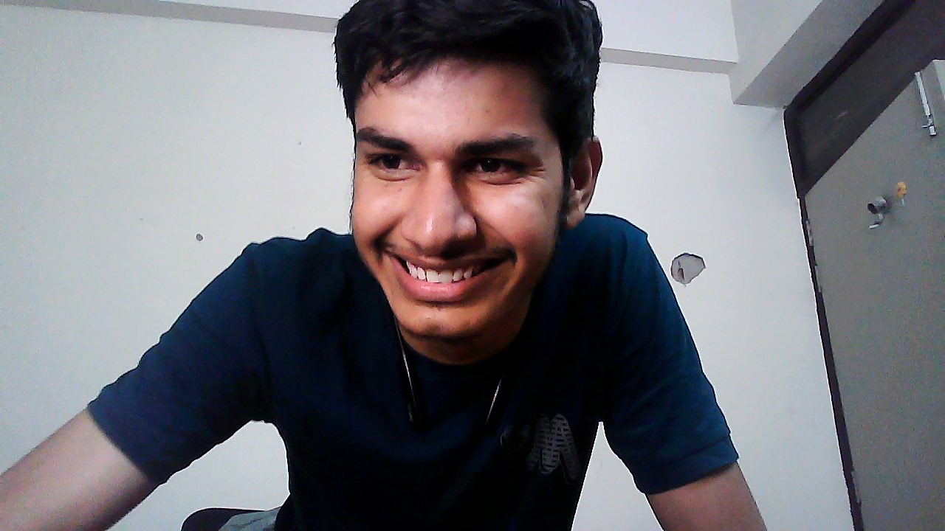
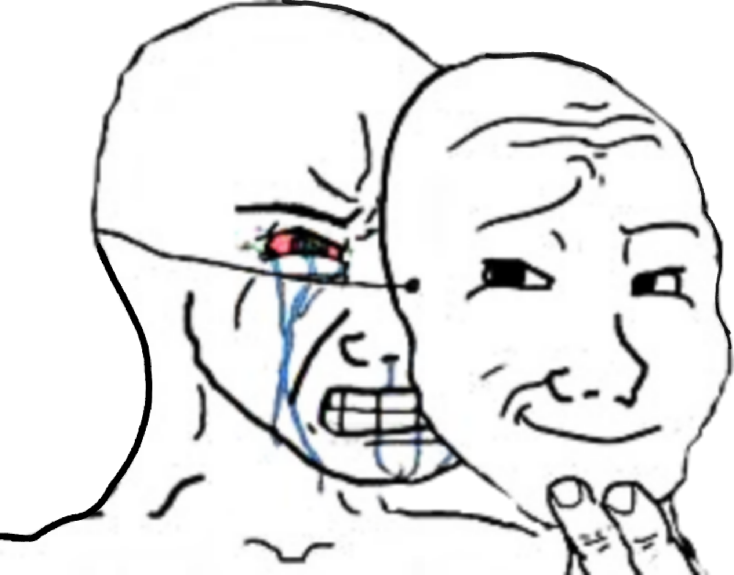
Unexpected :(
Notes:
We do got some, considerable expression most of time either the proposer gve a lot to them like 90 or took a lot from them, but like in the given image it was totally unexpected, the proposer gave him 6 rupee and rather being angry, he laughed.
The reason for this is that, we humans have praticed the art of hiding our emotions. Like me… I am here talking confidently while inside I know I am so nervous.

Slide 22
Conclusion

Slide 23
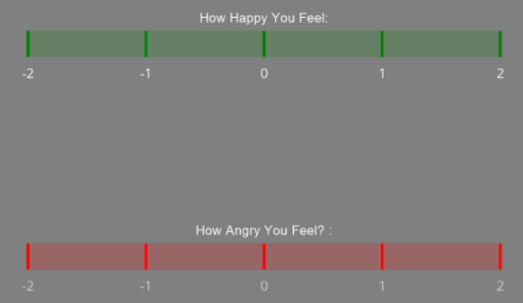
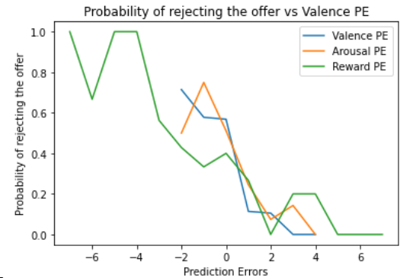
Sources Of Error
Small number of trials were taken for the game
Participant errors- lack of proper understanding, impatience
Approximation of the results as we are rounding off
Collecting PEs using our replicated dARM of two scales

Slide 24
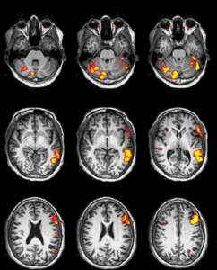
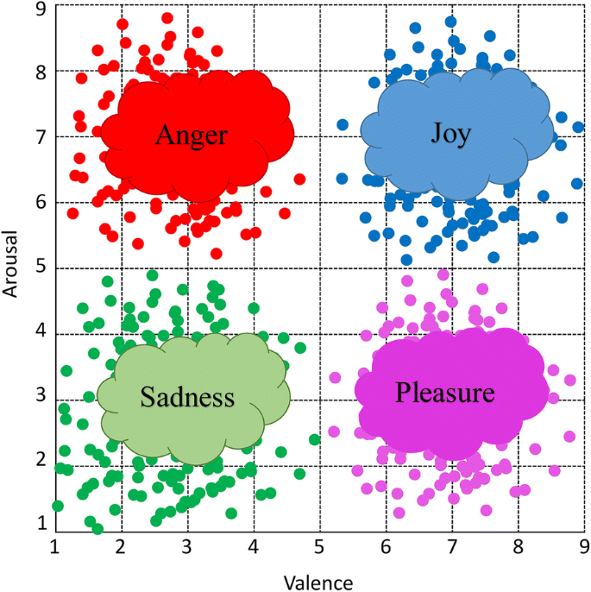
Future Prospects
Brainwave mapping to accurately assess change in emotions
Incorporate varying degrees of anonymity
Account for social discounting

Slide 25
ThanK U
We would like to give a big thank you to Arjun for always being there to help our queries. It was a wonderful experience working as your mentee.
Our group worked together as a team, we discussed, chalked out a plan and together landed it to perfection.

